Slide 1
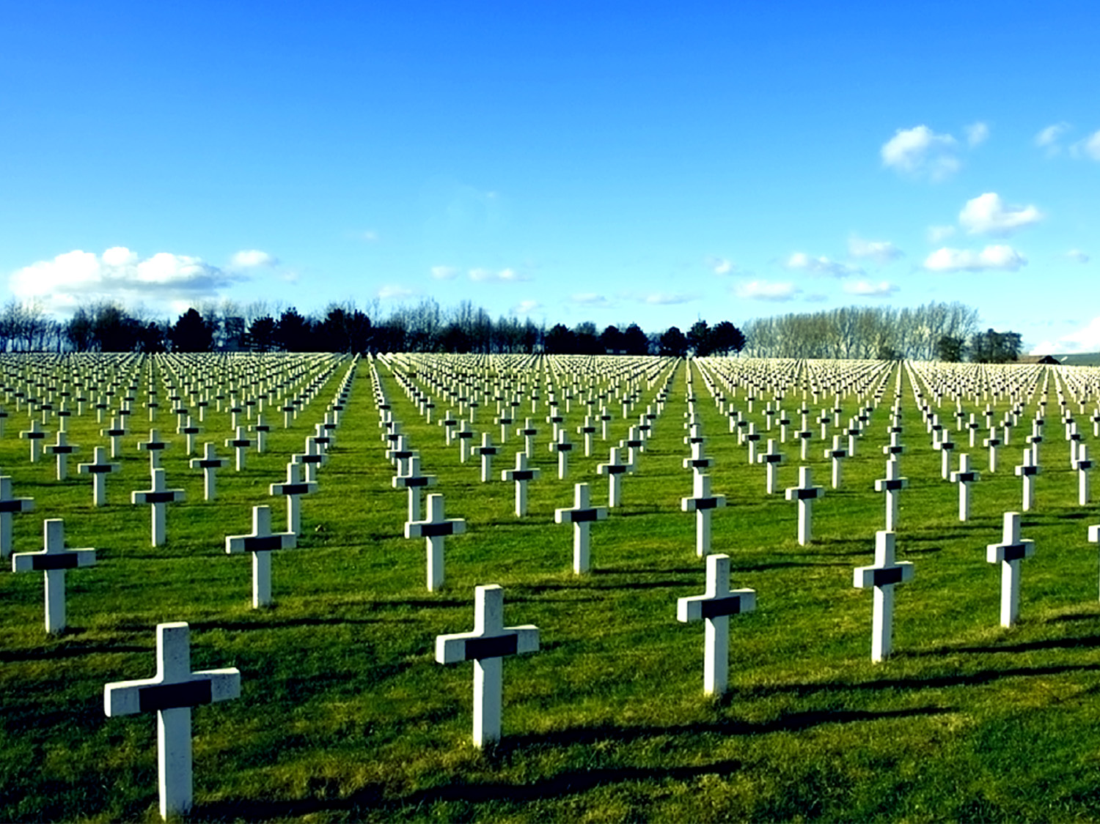
Freedom Isn’t Free
Memorial Day 2015
Galatians 5
Anthony Grove Baptist Church
Dr. Dennis E. Bean
May 24, 2015

Slide 2
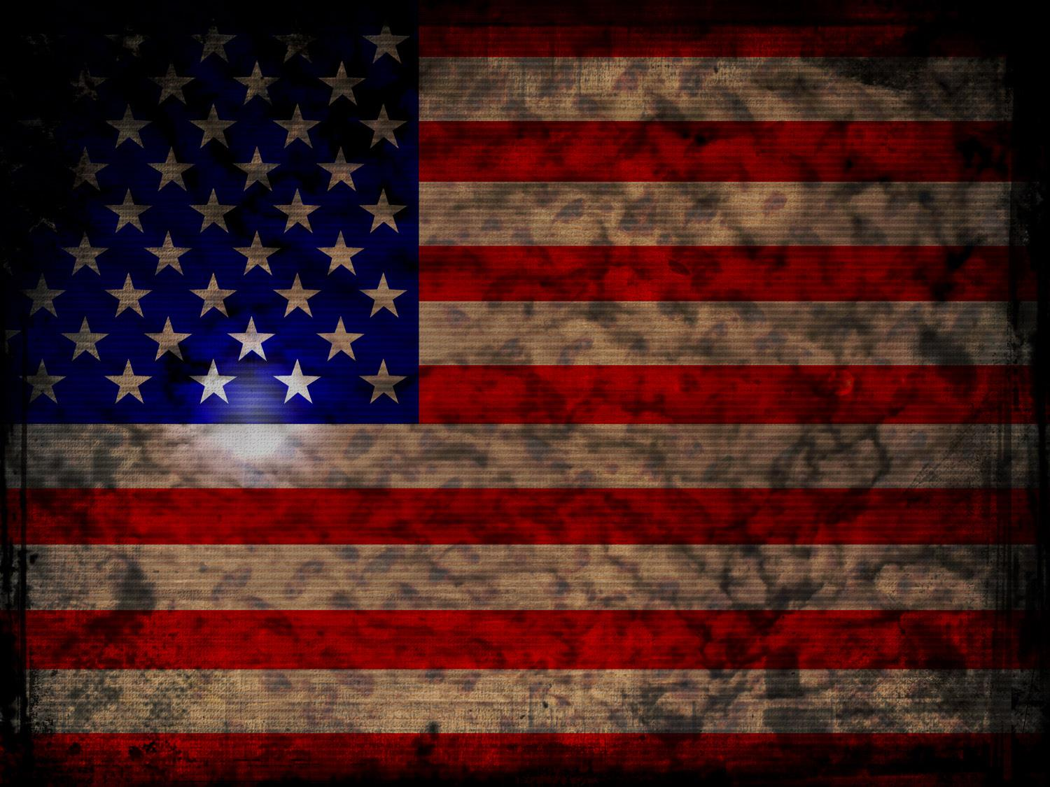
Galatians 5:1–14
¹ It is for freedom that Christ has set us free. Stand firm, then, and do not let yourselves be burdened again by a yoke of slavery. ² Mark my words! I, Paul, tell you that if you let yourselves be circumcised, Christ will be of no value to you at all. ³ Again I declare to every man who lets himself be circumcised that he is obligated to obey the whole law.

Slide 3

⁴ You who are trying to be justified by law have been alienated from Christ; you have fallen away from grace. ⁵ But by faith we eagerly await through the Spirit the righteousness for which we hope. ⁶ For in Christ Jesus neither circumcision nor uncircumcision has any value. The only thing that counts is faith expressing itself through love. ⁷ You were running a good race. Who cut in on you and kept you from obeying the truth?

Slide 4

⁸ That kind of persuasion does not come from the one who calls you. ⁹ “A little yeast works through the whole batch of dough.” ¹⁰ I am confident in the Lord that you will take no other view. The one who is throwing you into confusion will pay the penalty, whoever he may be. ¹¹ Brothers, if I am still preaching circumcision, why am I still being persecuted? In that case the offense of the cross has been abolished.

Slide 5
¹² As for those agitators, I wish they would go the whole way and emasculate themselves! ¹³ You, my brothers, were called to be free. But do not use your freedom to indulge the sinful nature; rather, serve one another in love. ¹⁴ The entire law is summed up in a single command: “Love your neighbor as yourself.”-- (NIV)

Slide 6
Galatians 5:19–21
¹⁹ The acts of the sinful nature are obvious: sexual immorality, impurity and debauchery; ²⁰ idolatry and witchcraft; hatred, discord, jealousy, fits of rage, selfish ambition, dissensions, factions ²¹ and envy; drunkenness, orgies, and the like. I warn you, as I did before, that those who live like this will not inherit the kingdom of God.-- (NIV)

Slide 7
Freedom Isn’t Free

Slide 8
1. There is A Cost to _________ Freedom.
Secure
Galatians 5:1¹ It is for freedom that Christ has set us free. Stand firm, then, and do not let yourselves be burdened again by a yoke of slavery.-- (NIV)

Slide 9
A. Your Freedom Cost __________________.
God His Son
John 3:16¹⁶ “For God so loved the world that he gave his one and only Son, that whoever believes in him shall not perish but have eternal life.-- (NIV)

Slide 10
B. Your Freedom Cost ____________________.
Jesus His Life
1 Peter 1:18–19¹⁸ For you know that God paid a ransom to save you from the empty life you inherited from your ancestors. And it was not paid with mere gold or silver, which lose their value. ¹⁹ It was the precious blood of Christ, the sinless, spotless Lamb of God.-- (NLT)

Slide 11
C. Your Freedom Cost ____________________________.
The Hero His Life
John 15:13¹³ Greater love has no one than this, that he lay down his life for his friends.-- (NIV)
D. Your Freedom Cost ____________________________.
E. Your Freedom Cost ____________________________.
The Family of the Fallen
Veteran His Injuries

Slide 12
2. There Is A Cost To _______________ Freedom.
Sustain
Galatians 5:1¹ It is for freedom that Christ has set us free. Stand firm, then, and do not let yourselves be burdened again by a yoke of slavery.-- (NIV)

Slide 13
A. You Can Be Enslaved By __________________.
Legalism
Galatians 5:7⁷ You were running a good race. Who cut in on you and kept you from obeying the truth?-- (NIV)

Slide 14
B. You Can Be Enslaved By __________________.
Materialism
Matthew 6:24²⁴ “No one can serve two masters. Either he will hate the one and love the other, or he will be devoted to the one and despise the other. You cannot serve both God and Money.-- (NIV)

Slide 15
C. You Can Be Enslaved By _____________________.
Drugs & Alcohol
Proverbs 20:1¹ Wine is a mocker and beer a brawler; whoever is led astray by them is not wise.-- (NIV)

Slide 16
D. You Can Be Enslaved By _________.
Food
Philippians 3:19¹⁹ Their destiny is destruction, their god is their stomach, and their glory is in their shame. Their mind is on earthly things.-- (NIV)

Slide 17
E. You Can Be Enslaved By _________.
Fear
1 John 4:18¹⁸ There is no fear in love. But perfect love drives out fear, because fear has to do with punishment. The one who fears is not made perfect in love.-- (NIV)

Slide 18
F. You Can Be Enslaved By ____________________.
Unforgiveness
Acts 8:23²³ For I see that you are full of bitterness and captive to sin.”-- (NIV)

Slide 19
G. You Can Be Enslaved By ________.
Lust
1 Thessalonians 4:4–5⁴ Then each of you will control his own body and live in holiness and honor—⁵ not in lustful passion like the pagans who do not know God and his ways.-- (NLT)

Slide 20
Keys To Freedom

Slide 21
1. Put Your ________ In Jesus Christ.
Faith
Luke 9:23²³ Then he said to the crowd, “If any of you wants to be my follower, you must turn from your selfish ways, take up your cross daily, and follow me.-- (NLT)

Slide 22
2. Maintain ______________ In the Body of Christ.
Fellowship
Galatians 5:6b ⁶ The only thing that counts is faith expressing itself through love.

Slide 23
Galatians 5:13
¹³ You, my brothers, were called to be free. But do not use your freedom to indulge the sinful nature; rather, serve one another in love.-- (NIV)

Slide 24
Freedom Isn’t Free

